Slide 1


How to apply for services and helpful tips to help you get the most out of your application package

Slide 2

What we will cover in today’s webinar
DSO overview and how to apply
What to expect—the application process and package
Tips to help you get the most out of your assessment
Top 5 ways you can use your application package beyond applying for funded services

Slide 3
DSO Overview
What is DSO?
Developmental Services Ontario (DSO) is the access point for adult developmental services funded by the Ministry of Children, Community and Social Services (MCCSS) in Ontario.
There are 9 DSO agencies across the province.

Slide 4
The DSO will help you:
understand and complete the application process.
determine the kind of services and supports you need.
get access to MCCSS funded services and supports that you need when they become available.
find information in your community.

Slide 5
Services you may be able to apply for include:
specialized supports,
Passport program,
housing supports,
community participation supports, and
caregiver respite supports.

Slide 6




How to apply for services
Get your eligibility documents ready
  Proof of age, proof of residency and a psychological assessment.
Call your area DSO
  Call 2-1-1 or visit dsontario.ca to find contact information.
Complete an application
  Meet with a DSO staff person to complete the application package.
Stay in touch
  Let your local DSO if your information changes.

Slide 7

What to expect--the application process and package
The application process
If you are eligible to receive MCCSS funded services, you will be connected to a DSO staff person in your area.
They will set up 2 meetings with you to help you complete an application package and determine the level of support you need.
You will need to have at least 2 people who know you well (e.g., parent, guardian, support worker, etc.) with you at the meetings.

Slide 8

The application package helps identify your needs
To make sure that we understand and identify the right services and supports for you, we look at your needs in 2 ways. We complete the Application for Developmental Services and Supports (ADSS) and Supports Intensity Scale (SIS) with you.
The ADSS and SIS help us understand your needs in some of the following areas:
communication,
current living situation,
likes and dislikes,
dreams and goals, and
what is important to you.

Slide 9
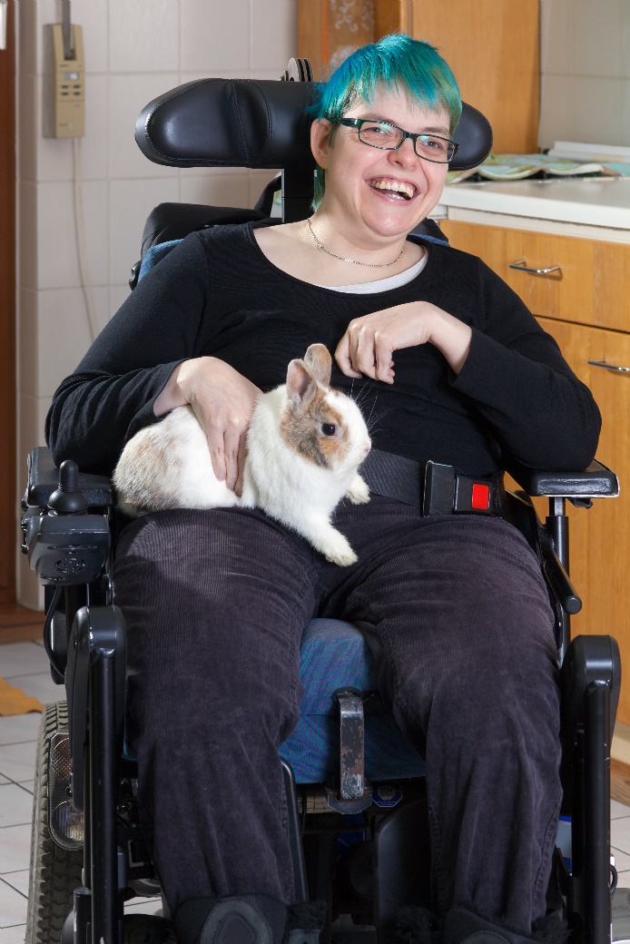
Application for Developmental Services and Supports (ADSS)
This part of the application helps us get to know you a little better. We will ask you questions that focus on some of the following topics:
your current services and supports and the one’s you’re requesting;
medical and/or behavioural needs;
financial status; and
caregiver concerns.

Slide 10

Supports Intensity Scale (SIS)
This part of the application tells us about the level of support you need to be successful in a variety of areas:
Home living
Community activities
Lifelong learning
Employment
Health and safety
Social activities
Protection and advocacy

Slide 11

Service Registry
Once we complete the application package and review your needs, we identify available services and supports in your area.
For services and supports that are not currently available, we place you on a service registry.

Slide 12

Tips to help you get the most out of your application package
The information you provide will identify the supports and services that fit your needs, now and in the future.
Make sure you:
give us as much information as possible.
tell us about activities you may want to participate in.
express what you want now and in the future.
provide accurate and realistic suggestions, because it may impact the services and supports you access in the future.

Slide 13

Top 5 ways you can use your application package
After you complete the application package, you will receive a detailed report that summarizes your unique needs.
When available, a DSO staff person will connect you to funded services in your area, but you can also use this information to help you…

Slide 14

Further benefits of the application
Starts the conversation with your caregiver(s) about the future and what needs to be done to support your long-term success
Brings your support people together (support network) to share information and ideas for supports you may need in different settings and scenarios.

Slide 15

Further benefits of the application
Outlines your support needs in 7 different areas of community participation, as well as, your current medical and behavioural support needs
A DSO staff person can provide you with information on programs, services and supports that you may benefit from (e.g. planning and locating a community resource or information session on a topic of interest)

Slide 16


How do I get started?
Call 2-1-1 (toll-free 1-877-330-3213) or visit dsontario.ca to find contact information for your area DSO.
Talk to your area DSO to find out what services and supports are available and are right for you.

Slide 17



CONNECT WITH US! dsontario.ca
Thank you!

